Slide 1

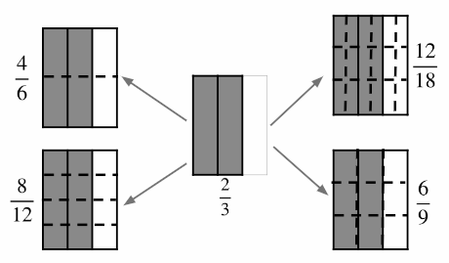



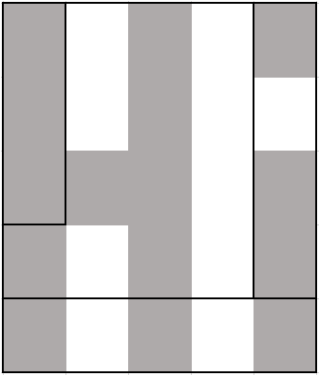
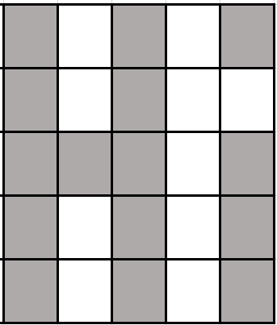
The identity property of multiplication and division
Task A: Bar models and number lines
By
subdividing,
create
fractions
that
are
equivalent
to
Lots of different ways as long as you have equal parts
2)
Sam
drew
a bar
to
show
Sam then drew another bar underneath
which
shows
Sam
then
said,
“It shows
is
equivalent
to
”
Is Sam correct? Explain why.
Incorrect. The bar that represents the whole must be the same length to compare fractions this way.
3)
Andeep
says
is shaded. Is he correct?
You can show your working out on the diagram.
Andeep is incorrect. Splitting the shape equally, there are 15 out of 25
15 out of 25 shaded is not equivalent to

Slide 2
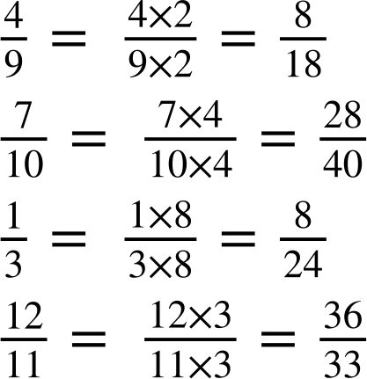











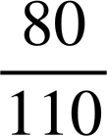
The identity property of multiplication and division
Task B: Property of multiplication
Fill in the gap to show the fraction, working out and equivalent fraction
a)
c)
b)
d)
2)
Shade
in the
equivalent
fraction
to
to reveal a picture.

Slide 3
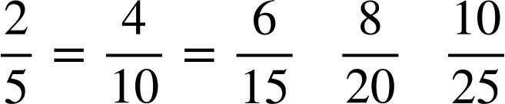
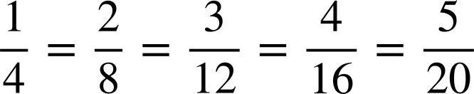
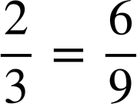
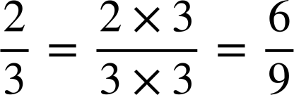
The identity property of multiplication and division
3) Here is a 5 by 5 multiplication grid.
1 | 2 | 3 | 4 | 5
2 | 4 | 6 | 8 | 10
3 | 6 | 9 | 12 | 15
4 | 8 | 12 | 16 | 20
5 | 10 | 15 | 20 | 25
Jacob uses it to help write the equivalent
fractions
to
He sees
Using the grid, can you find two more
equivalent
fractions
to
?
b)
Using
the
grid,
find
equivalent
fractions
to
and
4)
Show
using numbers lines, bar models and multiplication of 1
0
0
1
1
0
1
Mathematics in Education and Industry
v2.2

